Slide 1

Soft Computing Concepts

Slide 2
What Is Soft Computing?
Soft computing is an emerging approach to computing that parallels the remarkable ability of the human mind to reason and learn in an environment of uncertainty and imprecision.
Natural processes have always been the inspiration behind the design of soft-computing techniques. Soft-computing systems try to imitate, to some extent, the functionality given by natural processes—especially the human brain.
The guiding principle of soft computing is to exploit the tolerance for imprecision and uncertainty to achieve tractability, robustness, and low solution cost.
In reality, it might not be possible for any system to solve the problem in a finite amount of time. Hence we require soft-computing techniques to give the best possible results in the smallest amount of time.

Slide 3
What Is Soft Computing?
Optimization is about finding optimal values for parameters of an object or a system which minimizes an objective (cost) function.
Soft-computing techniques have a great deal of relevance in optimization problems, giving very good, time-efficient results.
These techniques generate a diverse set of solutions that they can then optimize to return the most optimal solution.
Soft computing hence means computation using soft conditions—that is, computing in which errors are undesirable but acceptable to a certain degree.
Soft computing is able to solve problems that either were impossible to solve using traditional methods or were computationally too expensive to solve.

Slide 4
Soft Computing Versus Hard Computing
Hard computing deals with precise computation. The rules of hard computing are strict and binding The inputs, outputs, and procedure are all clearly defined.
Since the rules are so well defined and the inputs so precise, it is possible to get precise answers without any degree of uncertainty. The same results will be returned, no matter how many times you perform the experiment.
An example of hard computing is the arithmetic sum. Whenever the inputs are 1 and 2, the output is 3.

Slide 5
Soft Computing Versus Hard Computing
Hard computing is thus better than soft computing in that it gives precise answers. There are certain limitations in the working of hard computing, especially when real-life data of enormous size is used :-
Model complexity and assumptions : Some problems are very difficult to model. Normally the approach for modeling a problem is to use a set of mathematical equations and variables. These equations are then solved simultaneously to get the final solution. But it is not always possible to model a problem in this way due to its complexity.
Computationally expensive problems : Giving a real-life data that are too large in size or dimensionality. With such large data, it will take the system a long time to compute the final result.
Space complexity: Many systems require a huge amount of memory to perform. It may not always be possible to have such a large amount of memory available.

Slide 6
Soft-Computing Systems
Soft computing started in the 1990s.
The major areas of application of soft computing are as follows.
All of these are active fields of research in the modern scientific society.
Biometrics
Bioinformatics
Biomedical systems
Robotics
Vulnerability analysis
Character recognition
Data mining
Music
Natural language processing
Multiobjective optimizations

Slide 7
Soft-Computing Systems
Wireless networks
Financial and time series prediction
Toxicology
Image processing
Machine control
Software engineering
Information management
Picture compression
Noise removal
Social network analysis

Slide 8
Artificial Intelligence
Artificial intelligence (AI) means adding intelligence to machines artificially so that they become intelligent and behave in ways similar to humans.
Artificial intelligence is the simulation of human intelligence on a machine, so as to make the machine efficient to identify and use the right piece of “knowledge” at a given step of solving a problem.
It is the science and engineering of making intelligent machines, especially intelligent computer programs.
AI systems have a great deal scope in making effective expert systems and decision support systems (DSS).

Slide 9
Problem Solving in Artificial Intelligence
AI uses a large number of tools and techniques and to many more algorithms that are designed as per the problem requirements.
The most commonly used and most basic set of algorithms are the graph search algorithms.
For example we have a problem to reach the goal vertex by traveling along the edges from vertex to vertex.
Edges are E = {1, 2, 3, 4, 5, 6}
Vertices are V = {(1,2), (1, 3), (1, 4), (2, 7), (4, 5), (4, 6), (3, 9), (6, 9), (5, 6), (7, 5), (5, 8)}.
One such solution has been highlighted. In notation, we would present this solution as 1 → 4 → 5→ 8. The algorithm returns true if the goal vertex is found.

Slide 10
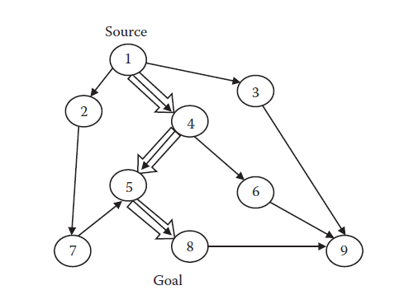
Problem Solving in Artificial Intelligence
These algorithms have many applications in scheduling, planning, game solving, and other such problems.

Slide 11
Problem Solving in Artificial Intelligence
The algorithms may be classified into two categories.
1.The class of algorithms that do not have any means to evaluate the
closeness of a vertex to the goal.
2.The algorithms that can evaluate the possible closeness of a vertex to
the goal based on a function know as the heuristic function.
Heuristic means rule of thumb. People develop their own rule of thumb based on their experience acquired over the years. Heuristic may be used to estimate, calculate, uncover, discover, purify, and simplify solutions to problems.

Slide 12
Problem Solving in Artificial Intelligence
The following are the most commonly used graph algorithms.
Breadth first search (BFS) :
This algorithm first visits the various nodes that are closer to the source and then proceeds to the farther ones.
Depth-first search (DFS) :
The DFS starts by going deep into the graph. It tries to expand nodes and penetrate deeper into the graph.
Iterative deepening depth-first search (IDDFS) :
This type of search follows the principles of the depth-first search, but we limit the maximum depth to a certain limit.
Best-first search :
This search selects the best possible nodes from the open list and expands them further.
A* search :
Instead of optimizing only the probable distance from the goal (heuristic), this search tries to optimize the total path.

Slide 13
Problem Solving in Artificial Intelligence
Multi Neuron heuristic search:
Instead of selecting the node with the best cost, it selects a number of vertices from the open list. The costs of these vertices vary from best to worst.

Slide 14
A * Algorithm
A*(graph, source, goal)
Step 1: closed, open ← empty list
Step 2: Calculate cost of open
Step 3: Add source to open
Step 4: While open is not empty
Do
Step 5: extract the node n from open with the least total cost
Step 6: If n = goal position, then break
Step 7: For each vertex v in expansion of n
Do
Step 8: if v is in neither open nor closed list, then compute costs of v and add to open list with parent n

Slide 15
A * Algorithm (continued...)
Step 9: if v is already in open list or closed list, then select the better of the current solution or the solution present already and update the cost and parent of the vertex
Step 10: if v is already in closed list, then select the better of the current solution or the solution present already and update the cost and parent of the vertex and all children from the vertex
Step 11: Add n to closed

Slide 16
Soft -Computing Techniques
Various concepts that collectively make up the field of soft computing are :
Artificial Neural Networks
Fuzzy Logic
Evolutionary Computing
New models, called hybrid systems, are currently being built from a combination of these techniques.

Slide 17
Artificial Neural Networks
The artificial neural network (ANN) is an attempt to imitate the functionality of the human brain.
ANNs are able to learn past data. They learn the data and then reproduce the correct output whenever the same input is applied.
ANNs have another extraordinary capability that allows them to be used for all sorts of applications:
Once they have been well taught the historical data, they are able to predict the outputs of unknown inputs with quite high precision. This capability, known as generalization.
ANNs are highly resistant to noise

Slide 18
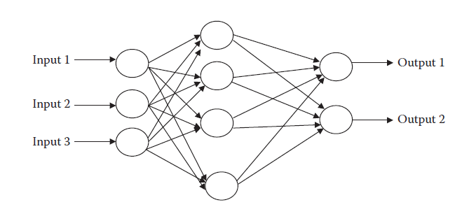
Artificial Neural Networks
The architecture of the artificial neural network.

Slide 19
Fuzzy Systems
Fuzzy systems are being used to model many real-life applications.
In fuzzy sets, every member of the set has a certain degree of belongingness to the set. This degree is called the membership degree.
The function that decides the membership degree, or belongingness, is known as the membership function. This function associates each member of a set with a degree or probability of belongingness.
Fuzzy systems are implemented by a set of rules called fuzzy rules, which may be defined on sets.
Fuzzy inference systems are systems formulating the mapping from a given input to an output using fuzzy logic.

Slide 20
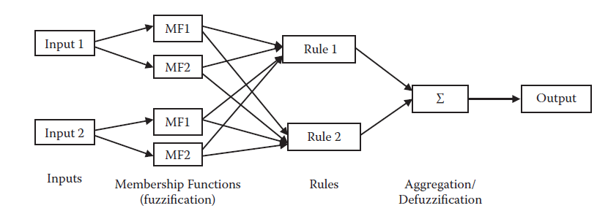
Evolutionary Algorithm Of Fuzzy Systems
The architecture of the fuzzy inference system.
Evolutionary algorithms are algorithms that maintain a population of structures that evolve according to the rules of selection and other operators, such as recombination and mutation.
Each individual in the population is evaluated, receiving a measure of its fitness in the environment.

Slide 21
Hybrid Systems
In hybrid systems, we try to mix the existing systems, with the aim of combining the advantages of various systems into a single, more complex system that gives better performances.
For example fusion of ANNs and FIS to make fuzzy-neuro systems.
Hybrid systems are highly beneficial in real-life application, such as in controllers. These controllers primarily use the fuzzy logic approach.

Slide 22
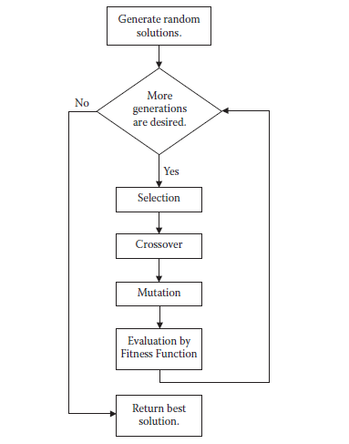
Hybrid Systems
Simple Genetic Algorithm

Slide 23
Expert Systems
An expert system may be defined as “knowledge-based systems that provide expertise, similar to that of experts in a restricted application area”.
The expert systems also require knowledge that needs to constantly update itself. All ES decisions are based on this knowledge.
The entire system can be divided into two parts: The first consists of the interface with the user where the required inputs are taken and the required outputs given.
The other part is the expert, which processes the inputs to generate outputs and tries to learn new things.

Slide 24
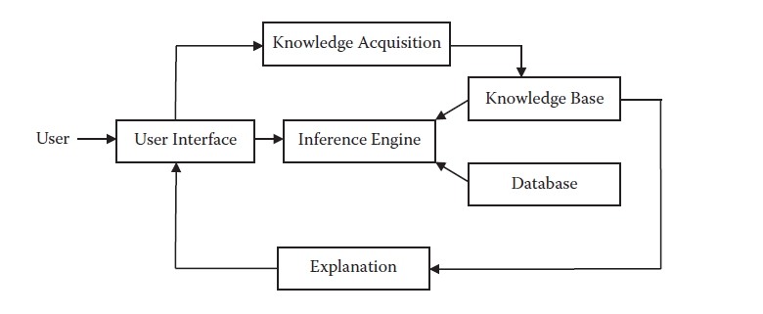
Expert Systems
The architecture of an expert system.

Slide 25
High-End Planning and Autonomous Systems
These are the systems which require a great deal of planning and effective decision making in an autonomous mode.
These autonomous robots are designed to do such tasks as chasing thieves, performing rescue operations, surveying unknown lands, and so forth.
In the field of robotics, various activities that need to be performed :
Data acquisition
Processing
Map building
Control
Path planning
Intelligent planning
Multirobot coordination

Slide 26
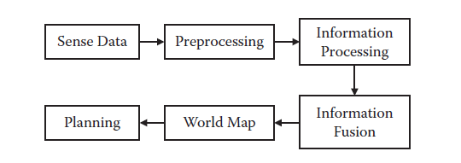
High-End Planning and Autonomous Systems
Architecture of the information processing and planning system in robots

Slide 27
Types of Problems
Looking at various types of problems that exist in the world, we can easily say that there are three main categories of problems for which soft computing is used—
Classification
Functional Approximation
Optimization.

Slide 28
Types of Problems
Classification Problem
In this we are supposed to map the inputs to a class of outputs. The system is supposed to see the inputs and select one of the classes to which the input belongs. Once an input is presented, if the system maps it to the correct class, the answer is regarded as correct.
Functional Approximation
In functional approximation problems, the output is continuous and is an unknown function of the inputs. For every input, there is a specific output in the entire output space.
Optimizations
In optimization, we are given a function, known as the objective function. The aim is to minimize or maximize the value of the objective function by adjusting its various parameters.

Slide 29
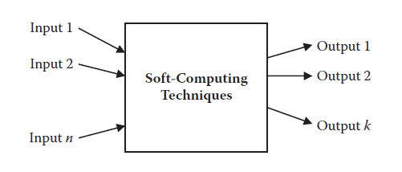
Modeling the Problem
The black box treatment of soft-computing techniques.
Input
For any soft-computing technique, it is important to identify the inputs. Too many inputs may make the system very slow. If our system has some feature that is not making a fine contribution to the output, that contribution may be neglected from the list of inputs. The input set contains the candidates that affect the output by a reasonable amount.

Slide 30
Modeling the Problem
Outputs
Because the system can only give valid outputs, not abstract ones, we need to decide the number of outputs and the type of every output according to the problem. The number of outputs must be limited to keep the complexity of the system low.
System
We need to build a system that maps the inputs to the outputs. The system may be built using any of the AI or soft-computing approaches.

Slide 31
Machine Learning
Machine learning is the ability of a machine to learn from the given data and to improve its performance by learning.
Machine learning refers to computer methods for accumulating, changing, and updating knowledge in an AI computer system.
Historical Database
The main focus in machine learning is to provide a good database from which the machine can learn. The system’s performance depends on the volume of data. The data need to be sufficiently large; otherwise the machine will make false predictions that might look correct to the user.
Data Acquisition
The standard practice for good machine learning is to make a database for all types of inputs. We use means specific to the problem to collect data for the purpose of machine learning.

Slide 32
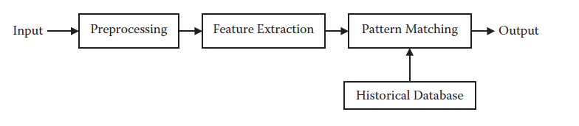
Machine Learning
Pattern Matching
Pattern matching is a collection of methods that can tell us whether and to what degree two given patterns or inputs match. Pattern-matching techniques can hence be used for any recognition system in which we are trying to match any given input to the known patterns available in a database. The pattern that corresponds to the highest match is regarded as the final pattern.
The various steps involved in a recognition system.

Slide 33
Handling Impreciseness
Any sort of experimentation has limitations and data always have some amount of impreciseness.
This impreciseness can pose a serious limitation to the system. The effect of impreciseness in soft-computing techniques is very low. Soft-computing techniques are appreciably resistant to noise and uncertainties prevalent in the data.
Uncertainties in Data
Uncertainties occur in data when we are not sure that the data presented are correct. It is possible that the data might be wrong. A related problem is the absence of data. In this case, the data for some of the inputs are completely absent and are not available in the system.
Noise
Noise in the data means that the data present in the database are not the same data present in the system. Rather the data in the database have been deformed or changed to a different value. The amount of deformation depends on the amount of noise.

Slide 34
Clustering
Clustering is the process to partition a data set into clusters or classes, where similar data are assigned to the same cluster whereas dissimilar data should belong to different clusters.
Clustering is used very commonly in soft computing for the purpose of analysis. Clustering reduces the amount of data so that we can easily visualize, plan, and model the system. In addition, clustering reduces the system’s execution time.
Some of the commonly used clustering techniques :
K-Means Clustering
Fuzzy C-Means Clustering
Subtractive Clustering

Slide 35
k-Means Clustering
This algorithm takes as its input a number k, along with the data to be clustered, and in return generates k clusters.
k-Means Clustering (k)
C ← random k centers
While change in cluster centers is not negligible
Do
For all elements e in data set
Do
Find the center ci, which is closest to e
Add e to cluster i
For all centers ci in C
Do
Ci ← arithmetic mean of all elements in cluster i

Slide 36


Fuzzy C-Means Clustering
In this algorithm, rather than associating every element with a cluster, we take a fuzzy approach in which every element is associated with every cluster by a certain degree of membership.
The degree of membership is large if the element is found near the cluster center.
The Algorithm :
For any element, the sum of the degree of belongingness to all clusters is always 1.
The center of any of the clusters is the mean of the points weighted by the degree of membership to this center..

Slide 37


Fuzzy C-Means Clustering
The degree of belongingness of any element e to the cluster i is the inverse of the distance between the element and the cluster center ci.
The coefficients are normalized and fuzzified with a real parameter m > 1 in order to make their sum 1.

Slide 38
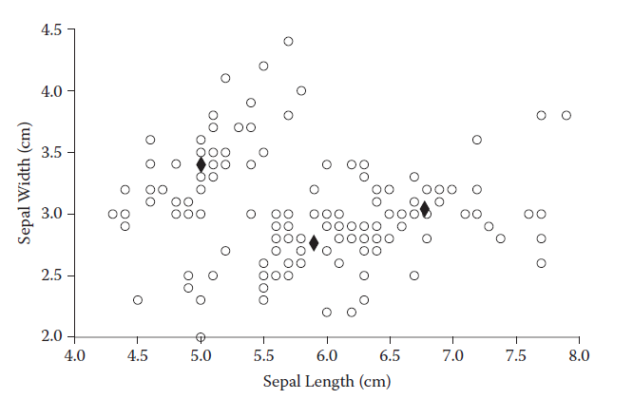
Fuzzy C-Means Clustering
Fuzzy C-means clustering. Note: The black dots indicate centers.

Slide 39
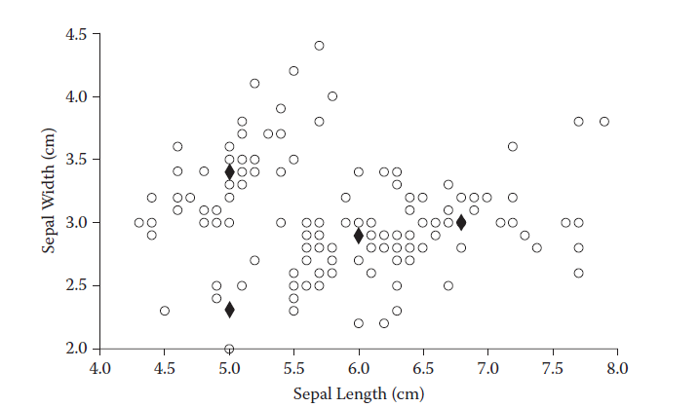
Subtractive Clustering
In subtractive clustering, however, the number of clusters does not need to be specified in advance. It thus may be used to find clusters when we do not wish to specify the number of clusters.
Subtractive clustering. Note: The black dots indicate centers.

Slide 40
Road Map for the Future
Soft-computing techniques have seen research in every domain, ranging from practical applications to theoretical foundations. There is, however, still a great deal of scope for things to be done in the future to enable people to better enjoy the fruits of soft computing.
Accuracy
The best accuracies of well-established systems may revolve around 99 percent to 99.9 percent. Attempts are being made to build better architectures and to extract better features in order to improve this accuracy.
Input Limitations
Soft-computing techniques largely depends on the size of the input data set, with higher data sets being a big boon to the system. The limited data-set size gives good results in experimentation but has huge limitations in real-life problems.

Slide 41
Road Map for the Future
Computational Constraints
Even though computation power has increased rapidly over the past few decades, an increase in expectations and performance of soft-computing techniques means we need greater computation power.
If computation power continues to grow, we may soon have systems that can perform much better in a shorter time.
Analogy with the Human Brain
The large computation in parallel by the biological neurons is what makes it possible for the brain to do everything it does.
It will take a very time for engineers to build any machine that is comparable to the human brain. But who knows, one day artificial life and artificial humans might turn out to be a reality.

